Slide 1
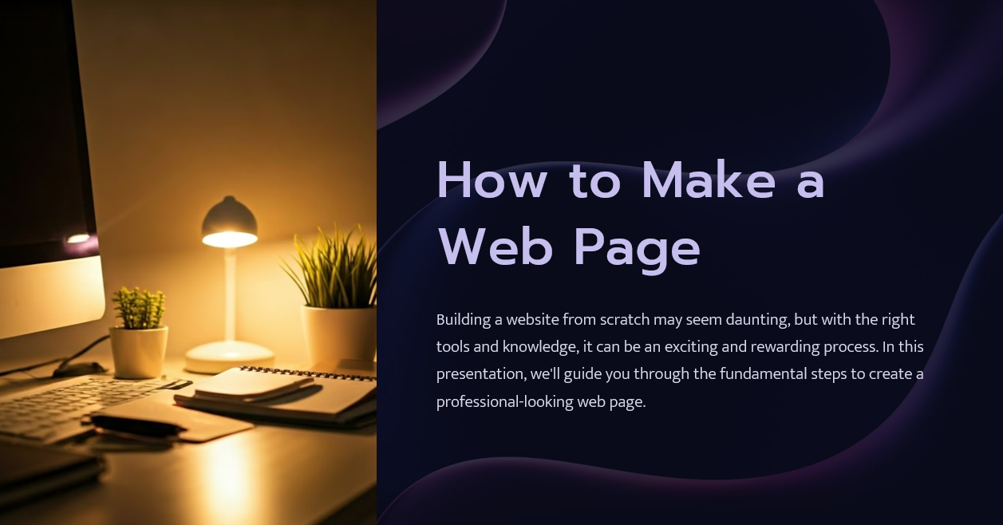


Slide 2
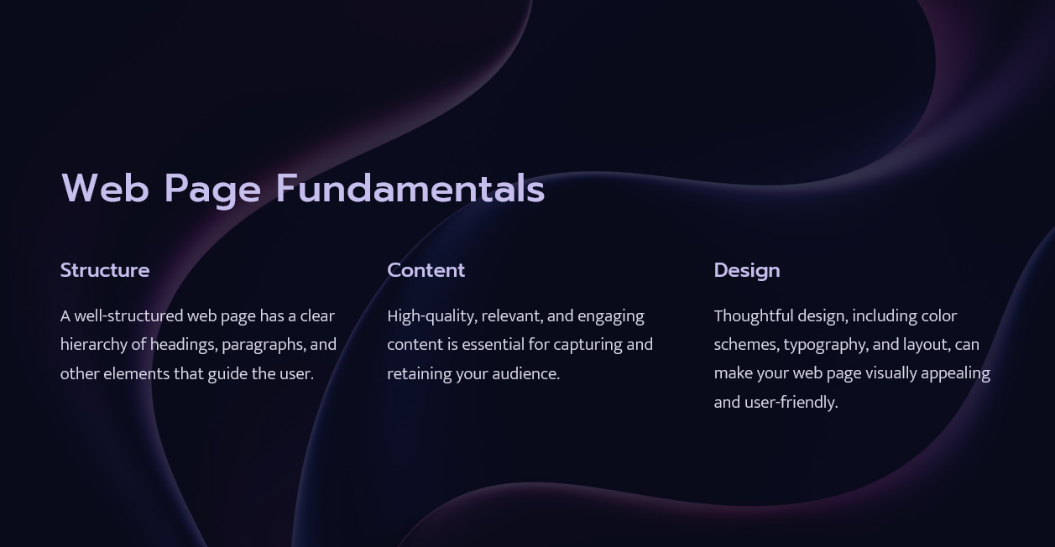


Slide 3
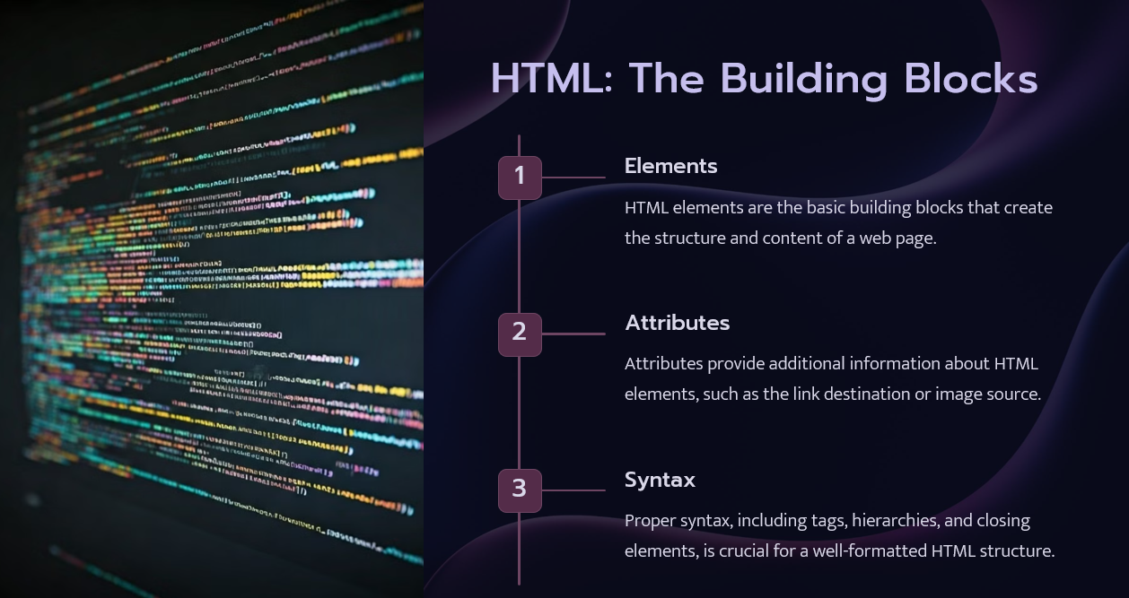


Slide 4
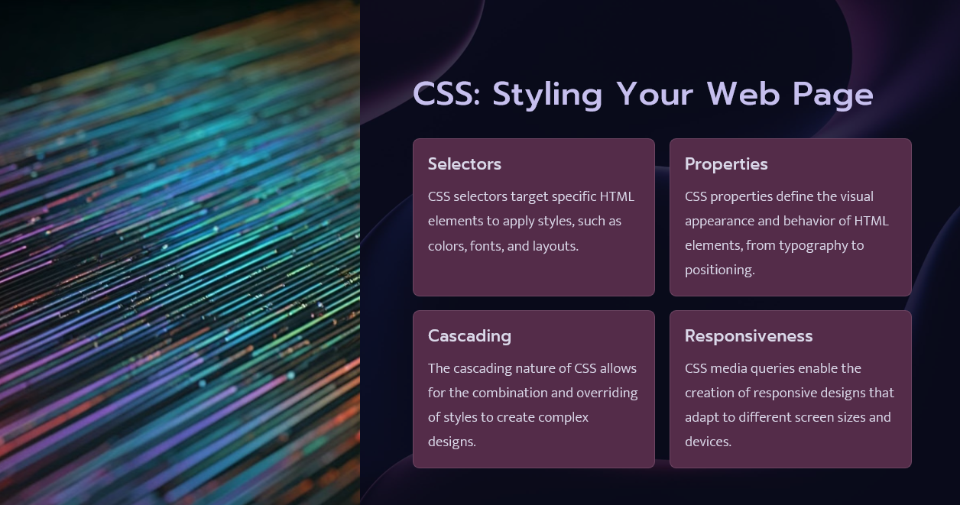


Slide 5
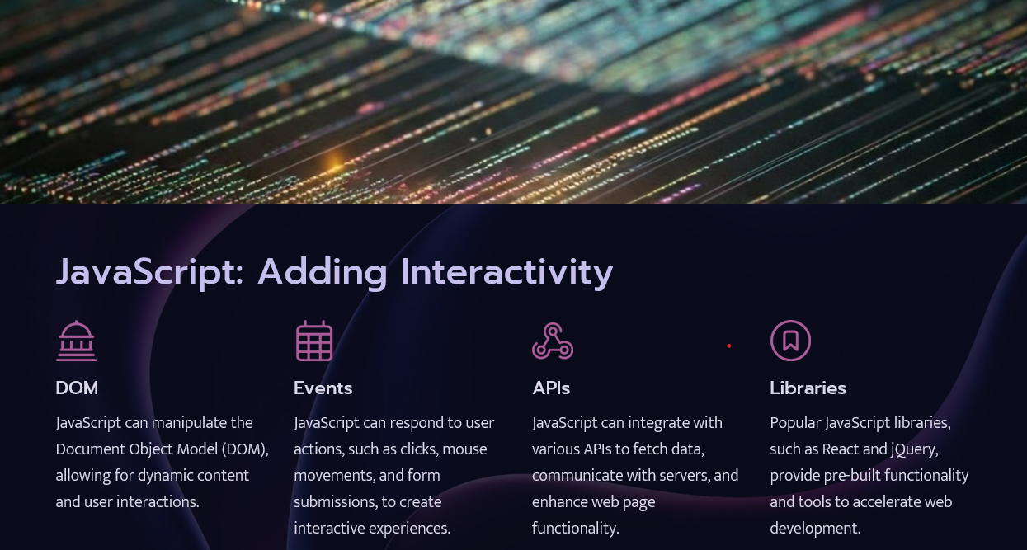


Slide 6
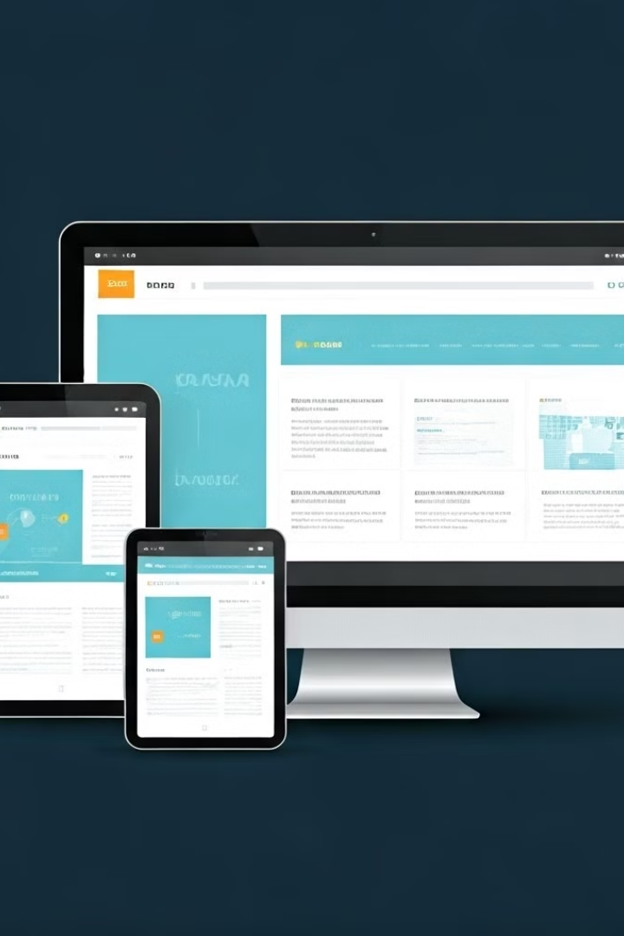




Responsive Web Design
Fluid Layouts
Responsive web design uses flexible grids, layouts, and media queries to create adaptable web pages.
Mobile-First
Designing for mobile devices first, and then progressively enhancing for larger screens, ensures a seamless experience.
Optimization
Optimizing images, scripts, and other resources for different devices and network conditions is crucial for performance.

Slide 7


Web Page Optimization
1
Page Speed
2
Search Engine Optimization (SEO)
Optimizing page load times through techniques like image compression and code minification enhances the user experience.
Optimizing web pages for search engines, using techniques like keyword placement and meta tags, can improve visibility.
3
Accessibility
4
Analytics
Ensuring your web page is accessible to users with disabilities is crucial for inclusivity and compliance.
Tracking user behavior and website performance using analytics tools can inform ongoing improvements and refinements.

Slide 8


Publishing Your Web Page
Web Hosting
Selecting a reliable web hosting service to store and serve your web page files.
Domain Name
Registering a unique domain name that aligns with your website's branding and identity.
File Transfer
Uploading your web page files to the web hosting server using tools like FTP or SFTP.
Testing
Thoroughly testing your web page to ensure it's functioning correctly and optimized for various devices.

